Slide 1
Volcan Mountain Foundation
Wildlife Imaging Team
Presentation to SDMMP 04/24/2019 by
Bill Carter
Susan Carter
Amy Eppert

Slide 2
Presentation to SDMMP
Brief History of VMF – Susan Carter
Brief History, Organization and Goals of WITS – Bill Carter
How the Images are Collected and Use of Google Sheets to enter Data – Susan Carter
Example of Using R-Shiny Tables, Graphs and Charts – Bill Carter
The Nuts and Bolts of Google Sheets and R-Shiny – Amy Eppert
Future Capabilities for Google Sheets/R-Shiny – Bill Carter
How You Can Work with R-Shiny on Your Projects

Slide 3
“Volcan Mountain – Not Your Ordinary Mountain”
  The Mission of the Volcan Mountain Foundation is conservation and stewardship of the Volcan Mountains complex, situated within the Peninsular Ranges of Southern California. It stretches 15 miles from Lake Henshaw basin southeast to 5 miles east of Julian, encompassing 18,000 acres.
Why is Volcan Mountain important?
  Headwaters for Four Watersheds
  North-South linkage between preserved lands in Palomar Mountain and Cuyamaca/Laguna Mountains.
  East-West linkage between preserved lands in the San Dieguito Park (Santa Ysabel Preserve) and Anza Borrego Desert State Park.
  30 different native vegetation community types, including mixed oak/coniferous/bigcone/Coulter pine forests, riparian woodlands, freshwater marshes, extensive meadows and annual grasslands.
  Elevations to 5,850 feet.

Slide 4
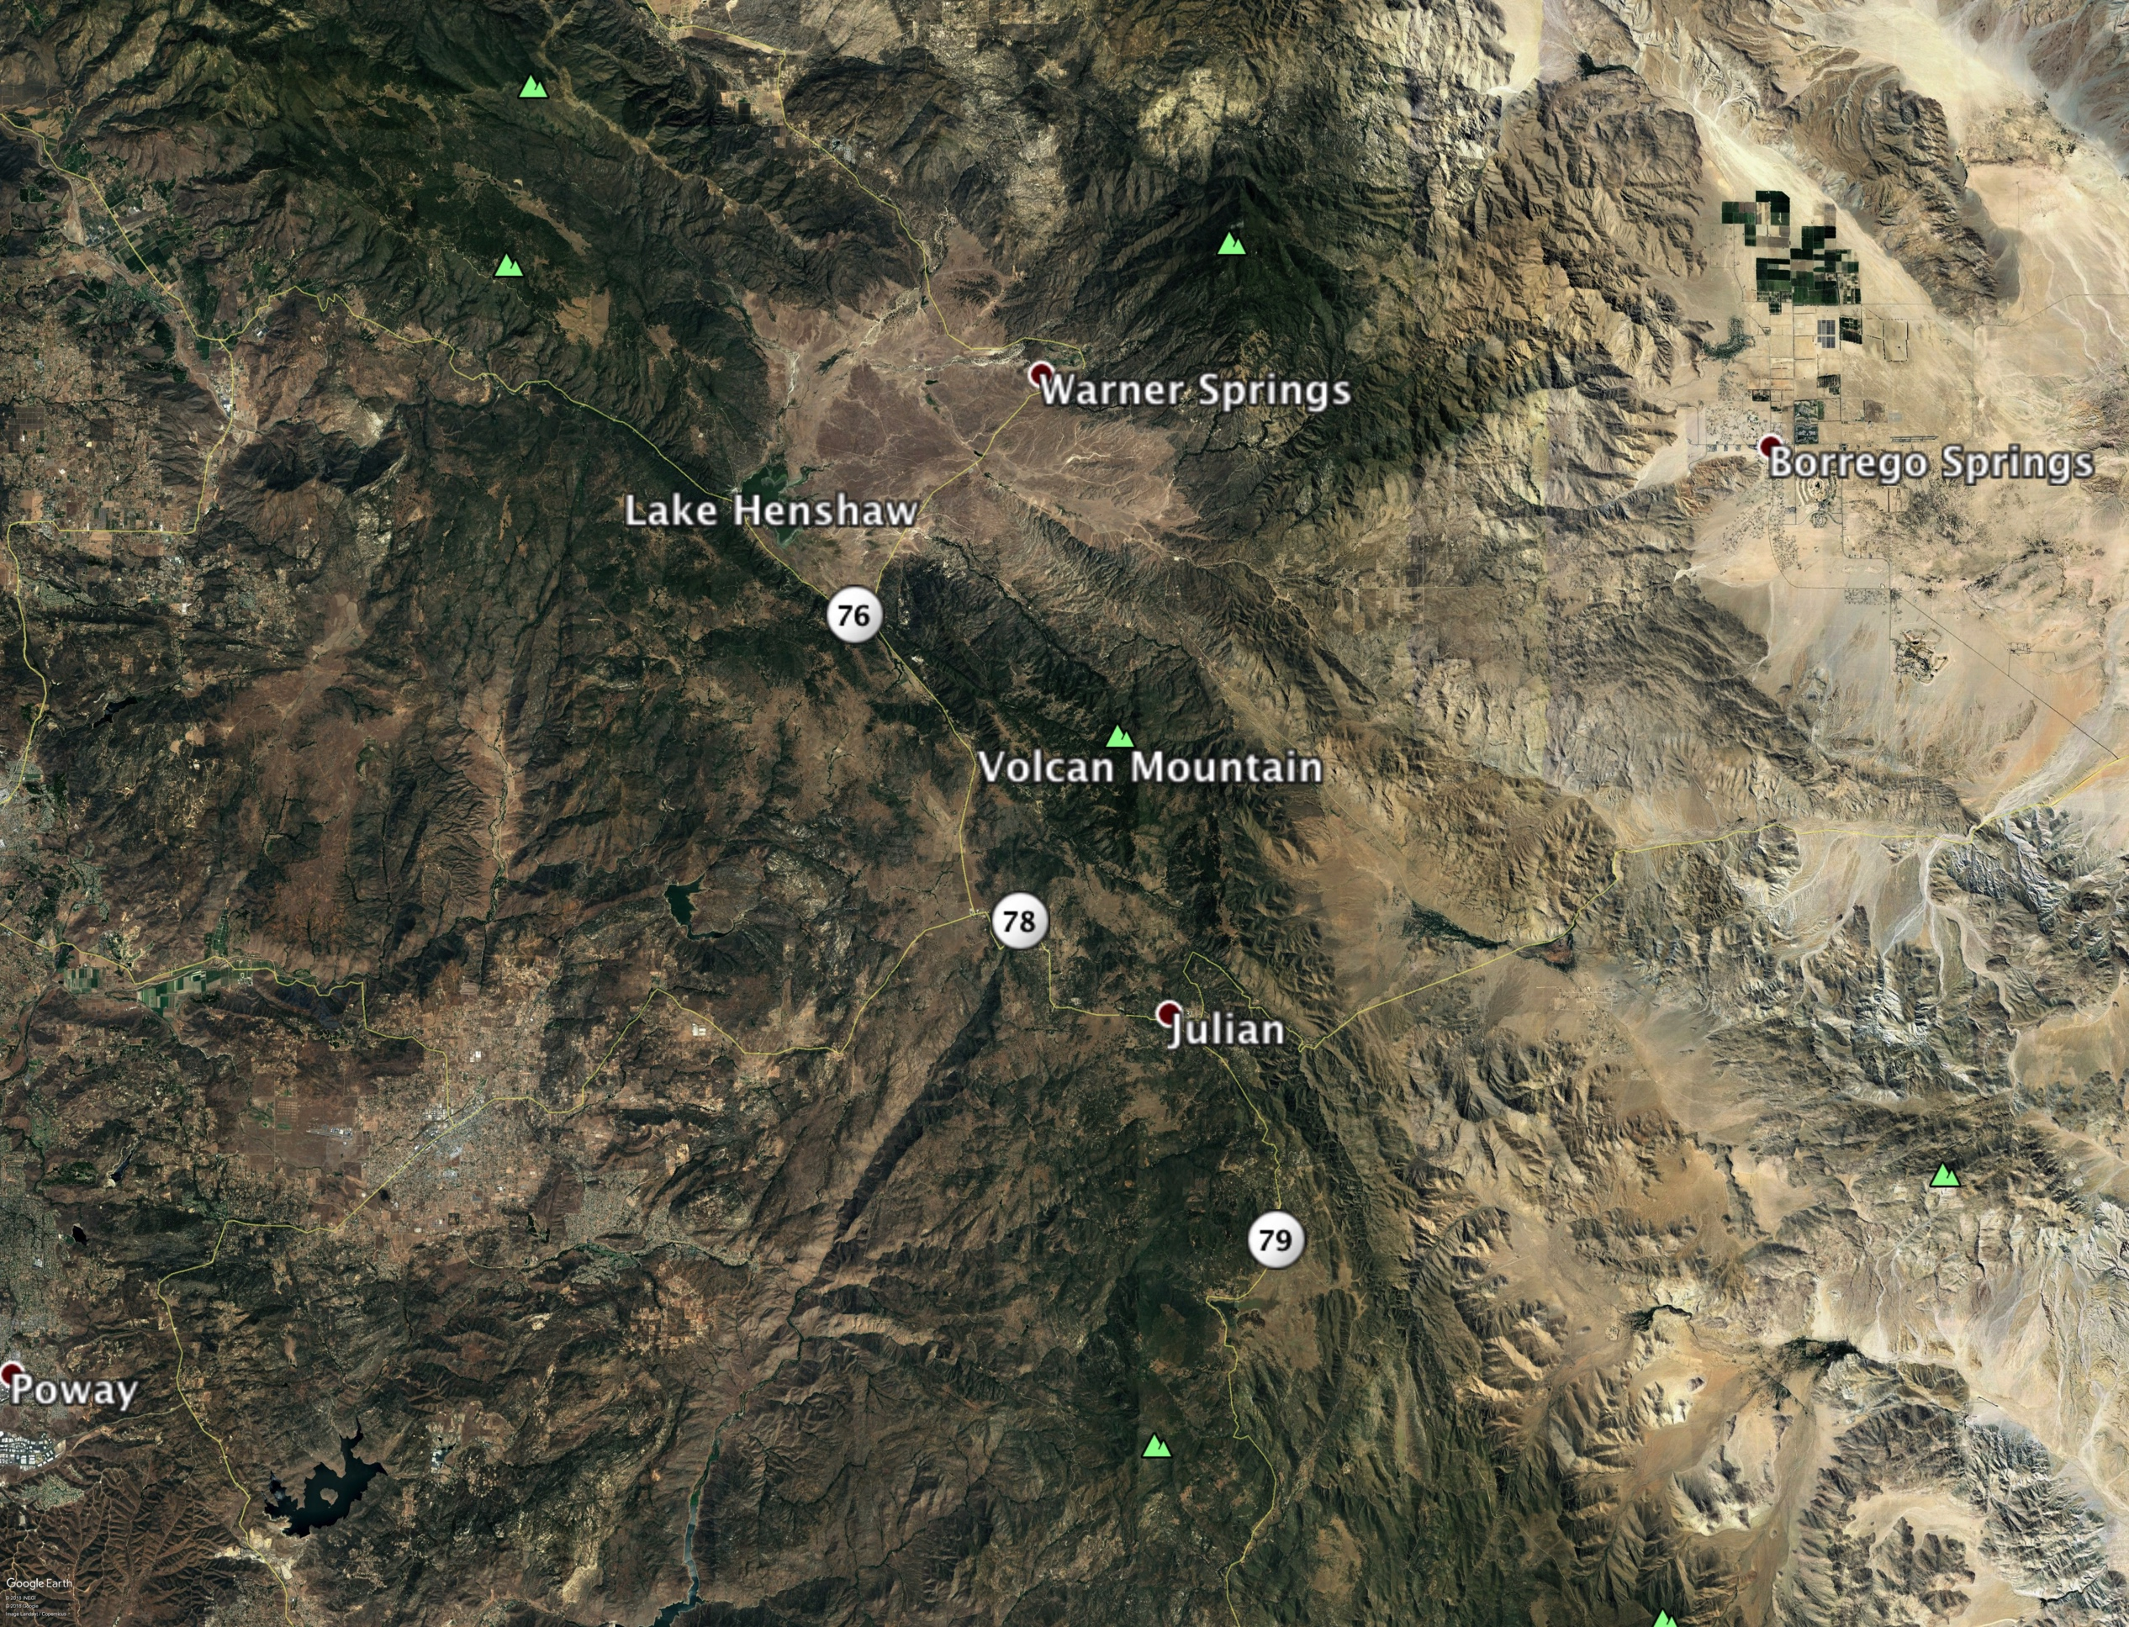

Slide 5
Volcan Mountain Foundation
A 24-unit development was proposed in 1987 for a pristine area of the mountain by an entity called First Fruit, Inc. This proposal galvanized the citizens. Wearing t-shirts that said “Volcan, NOT your ordinary mountain” they made many trips down to the County Planning Commission to protest the development.
The Volcan Mountain Foundation was formed in 1988.
Looking for a win-win solution, the Foundation’s founders (notably Peter Bergstrom and John Horton) met with then County Parks Director Bob Copper, seeking funds to acquire the property.
When California Parks Bond Act Proposition 70 was approved by the voters in November 1988, Bob Copper secured the funds to make that first purchase.

Slide 6
Lands Preserved Now on Volcan Mtn
Agency Acres
San Diego County Parks & Recreation 2,645
Calif. Dept. of Fish & Wildlife (VM & San Felipe) 8,329
Julian Community Services District 19
San Dieguito River Park JPA 592
San Dieguito River Valley Conservancy 23
Volcan Mountain Foundation 380
TOTAL 11,988

Slide 7
Brief History, Organization and Goals of WITS
Wildlife Imaging Teams (WITS) formed by the Volcan Mountain Foundation in 2014 – a totally volunteer effort initiated by Kathleen Beck and Sheana Fry.
Formed alliance with Point Loma Nazarene University --Dr Mooring and Dr. Botts -- in 2015 using faculty supervised student intern projects.
WITS Goals:
  Document the presence of significant species on Volcan Mountain and monitor both the long-term health of these species and their habitats on the mountain.
  Document the major wildlife corridors and trails used by the keystone, umbrella or indicator species. Partner with adjacent property owners, where possible, to monitor these wildlife corridors .
  Assist the VMF in identifying additional critical land acquisitions.

Slide 8
Brief History, Organization and Goals of WITS
Current Organization – 11 camera traps, 5 teams with two members each and one private land owner.
  Developed written protocols for establishing sites, operating and updating camera traps, storing images and data entry.
Limitations, Problems and Opportunities
  First historical data gathered in 2015 because 2014 and 2015 data not compatible – wanted an integrated database.
  Limited access to 380 acres owned by VMF – need more access to other habitats – means new sites and species.
  Data management problems – inconsistent data entry and “too much data” –needed a way for each team to enter and validate data.
  Need a way to link images to Google Sheet and R-Shiny analysis – currently manual “hyperlink”
  Improve imaging technology to identify individuals (or at least gender) for key species.

Slide 9
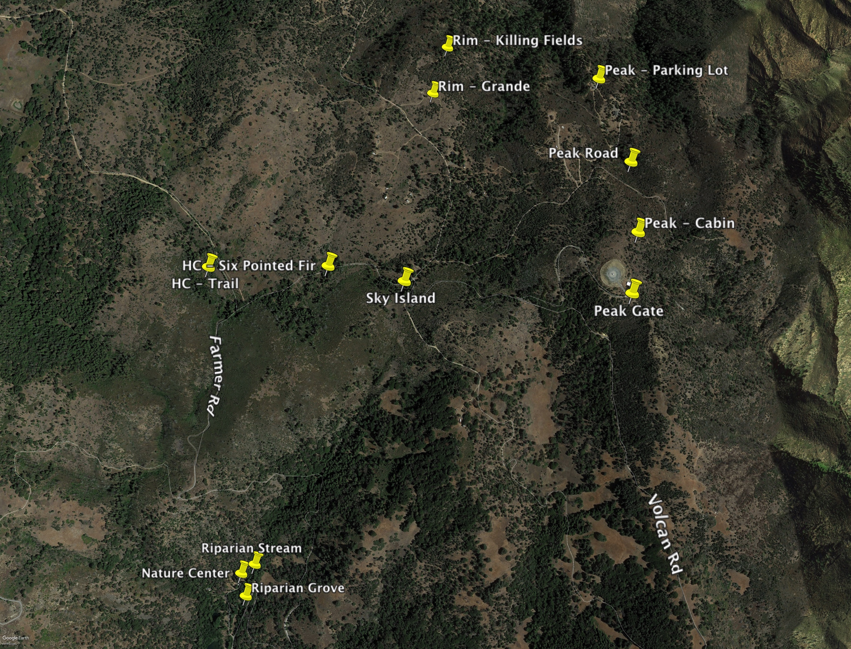
Camera
Locations
Elevations:
HC-Trail 5072’
HC-Six ptd Fir 5127’
Rim-Grande 5034’
Rim – KF 4873’
Peak Cabin 5477’
Peak Road 5222’
Peak Gate 5529’
Peak Parking 5477’
Stream – 4250’
Grove – 4160’
Sky Island 5177’

Slide 10
How the Images are Collected and Use of Google Sheets to enter Data
The volunteer teams collect their camera cards at least monthly, replacing them with a blank memory card and fresh batteries.
Following protocol, they copy the images to the computer at the VMF Nature Center. They review the images, noting what species and how many are seen.
They enter the new data for the cameras they are monitoring into a Google Sheet. Google Sheets allow different users to enter data at the same time from different locations. Google Sheets maintains an archive of changes made.
The VMF Google Sheet is a database with a key for Site, Species, Season/Year. It is easy to add additional sites and species.

Slide 11
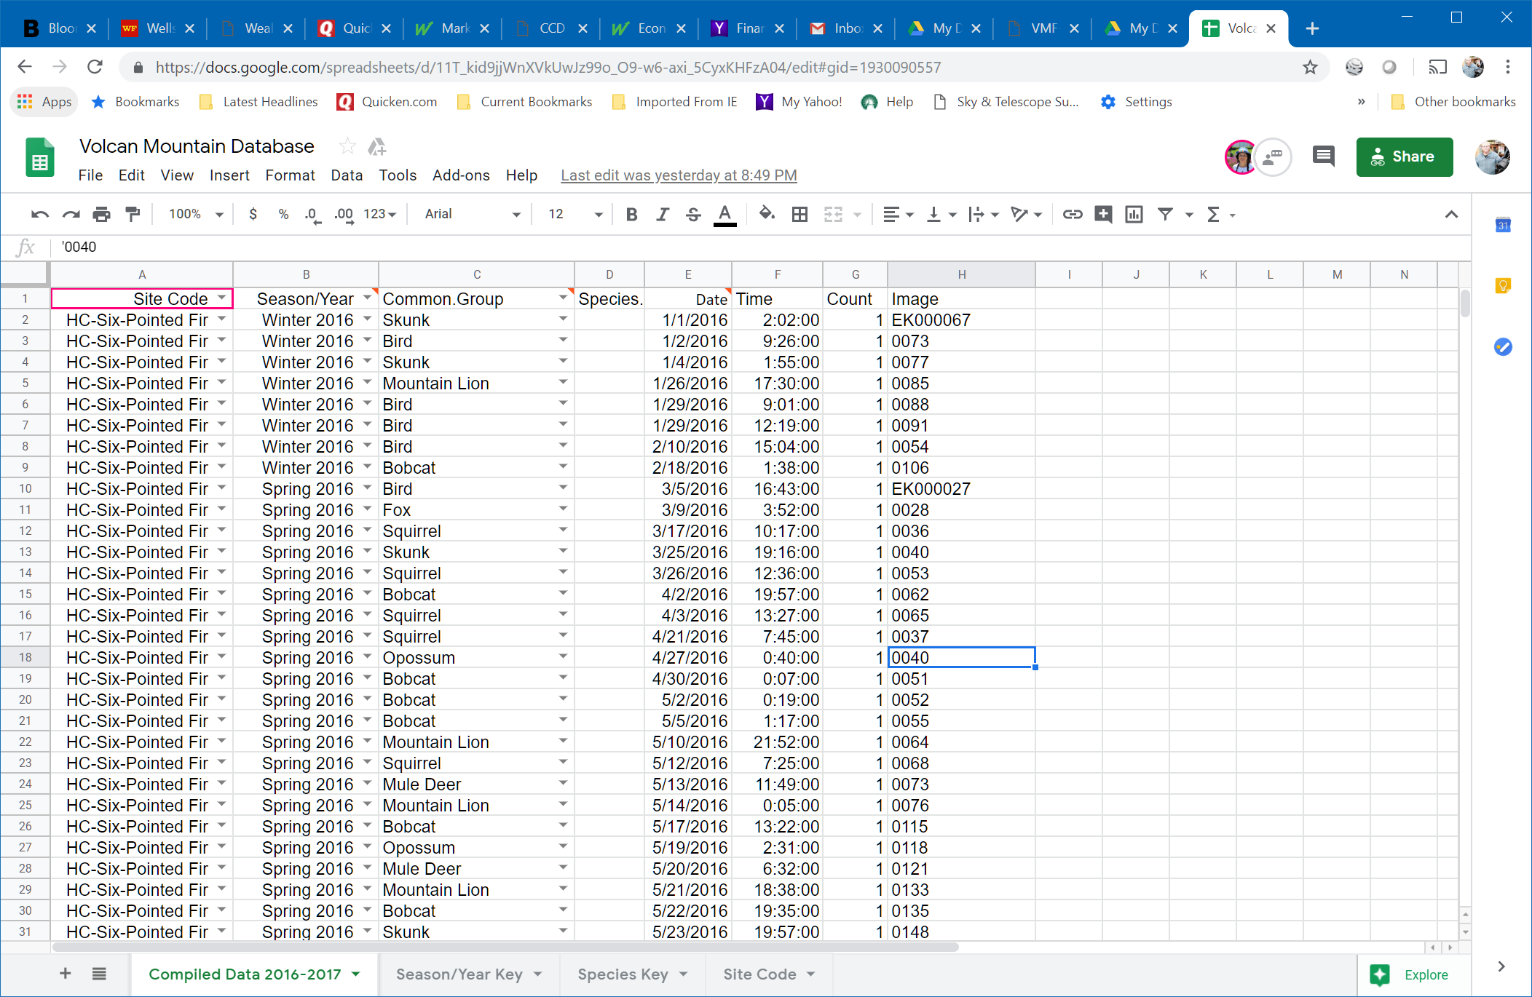

Slide 12
Example of Using R-Shiny Tables, Graphs and Charts – Bill Carter

Slide 13
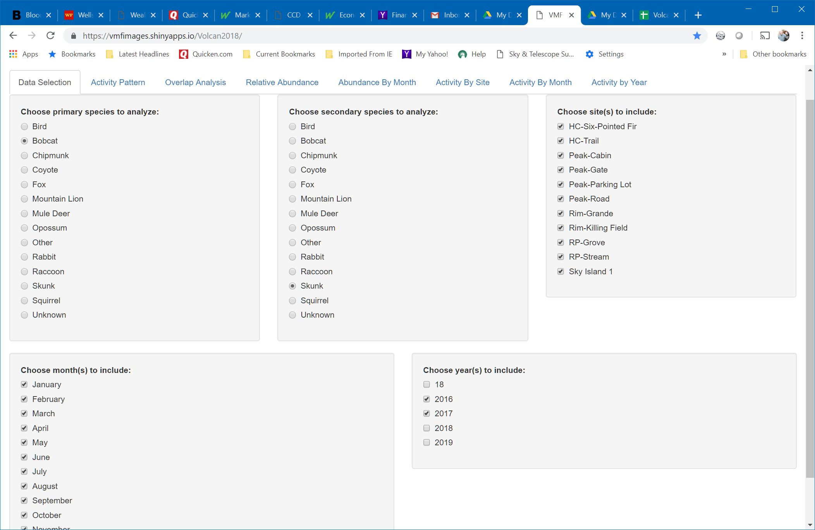

Slide 14
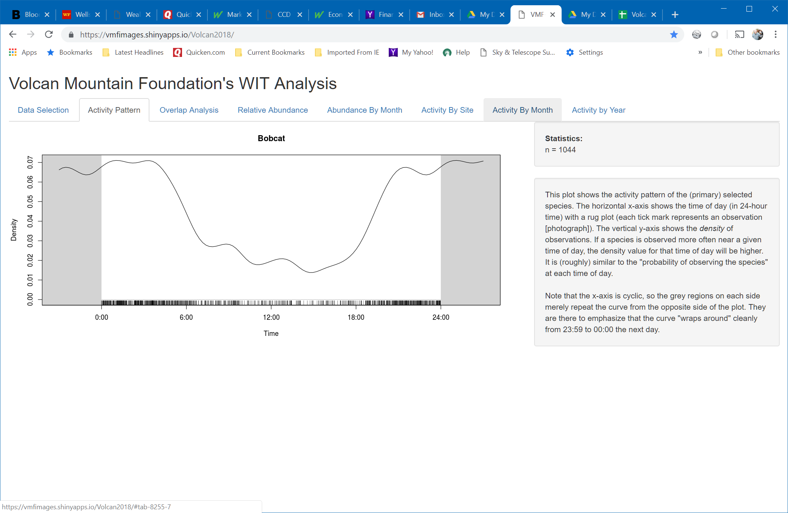

Slide 15
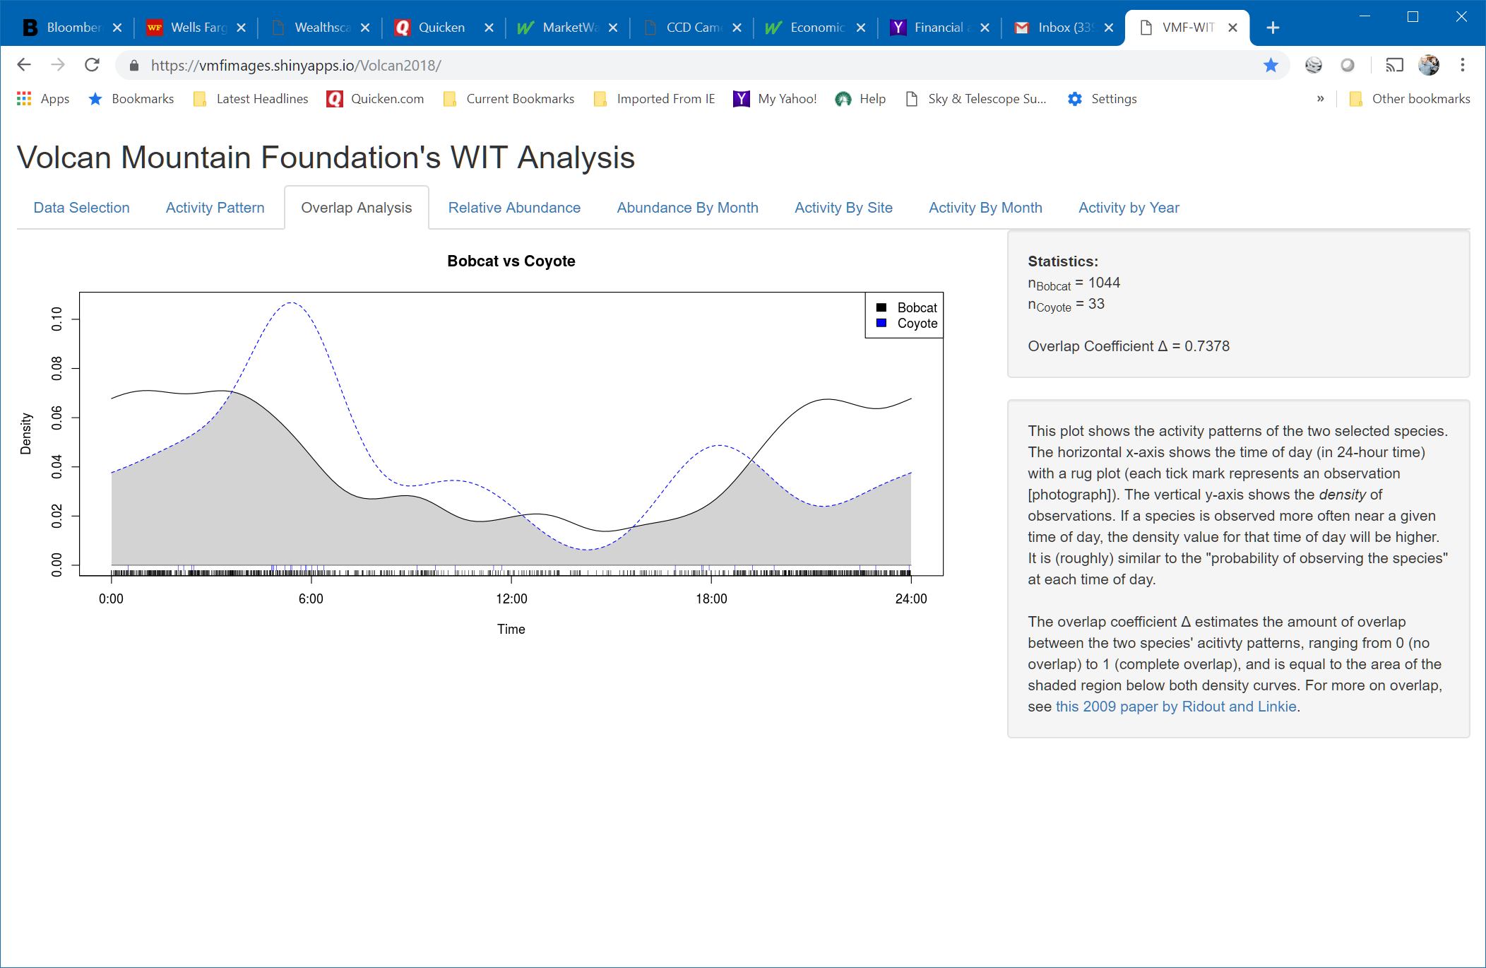

Slide 16
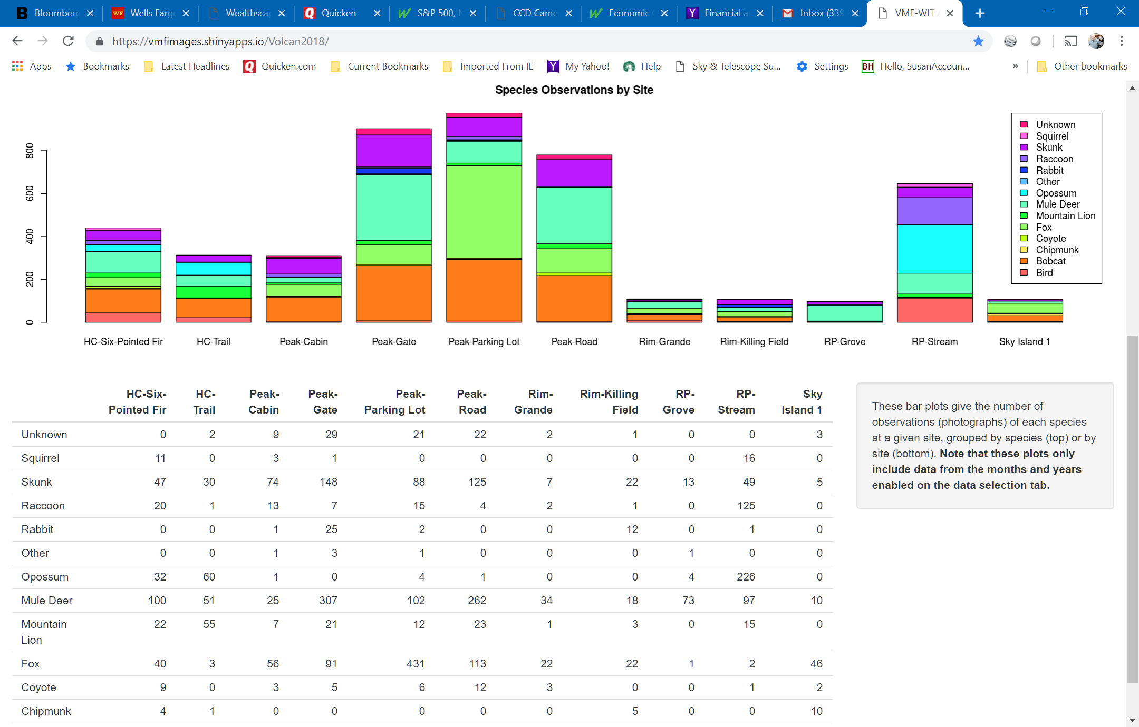

Slide 17
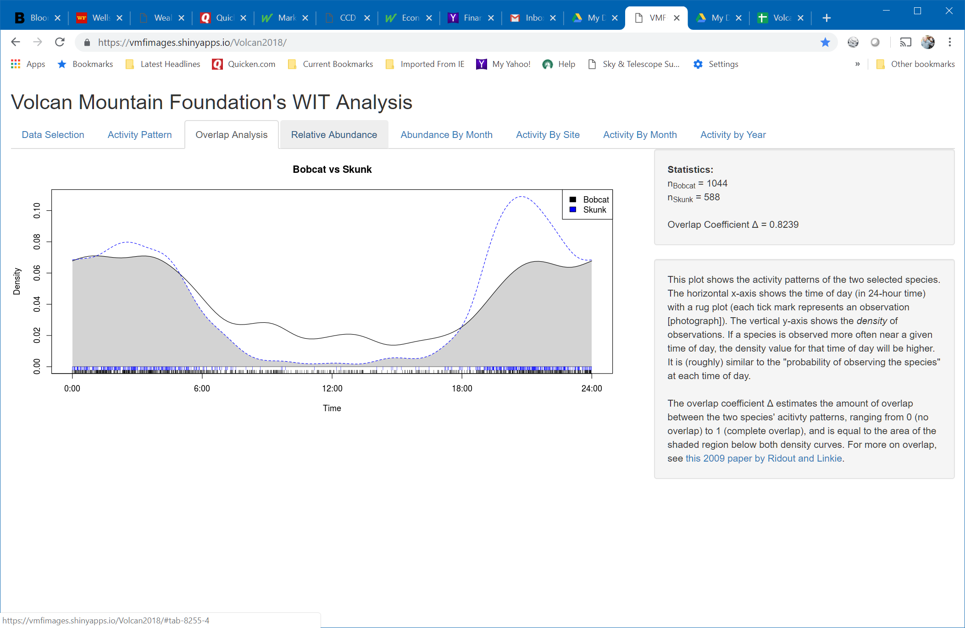

Slide 18
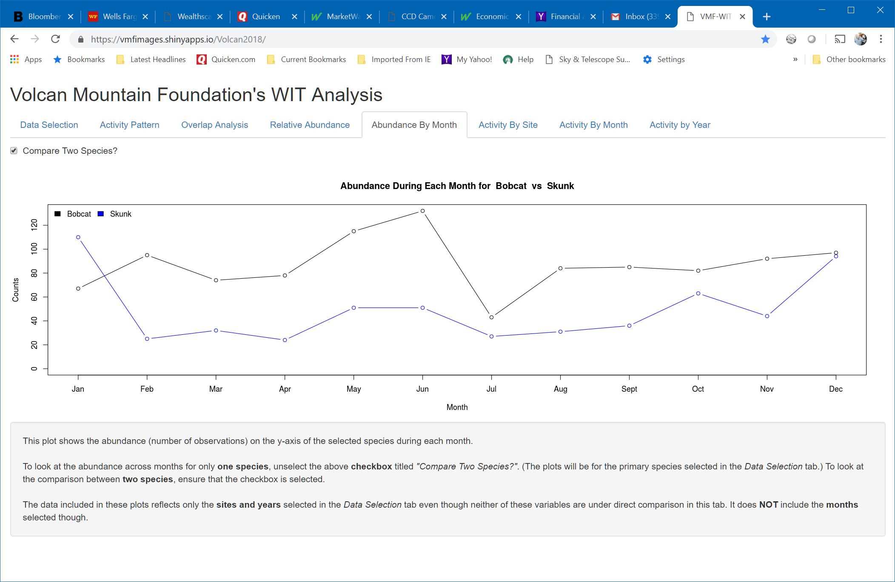

Slide 19
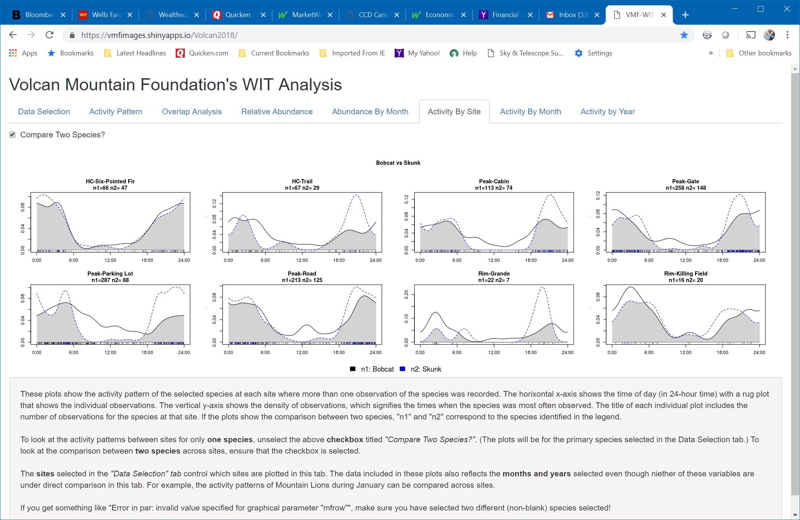

Slide 20
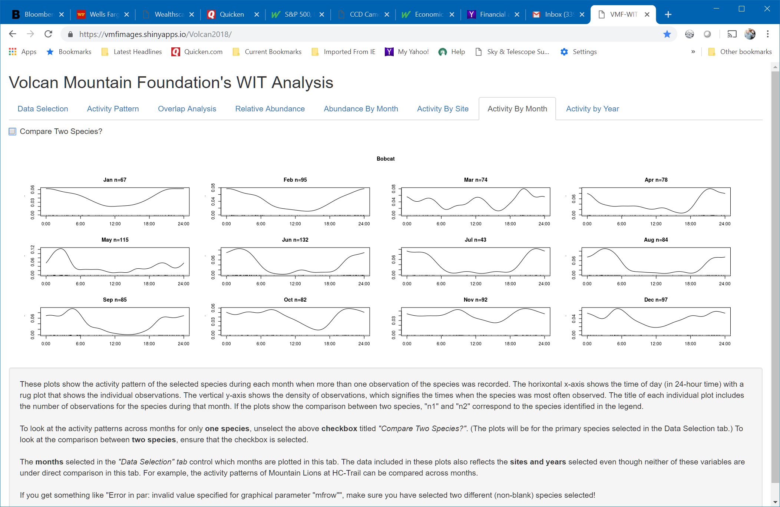

Slide 21
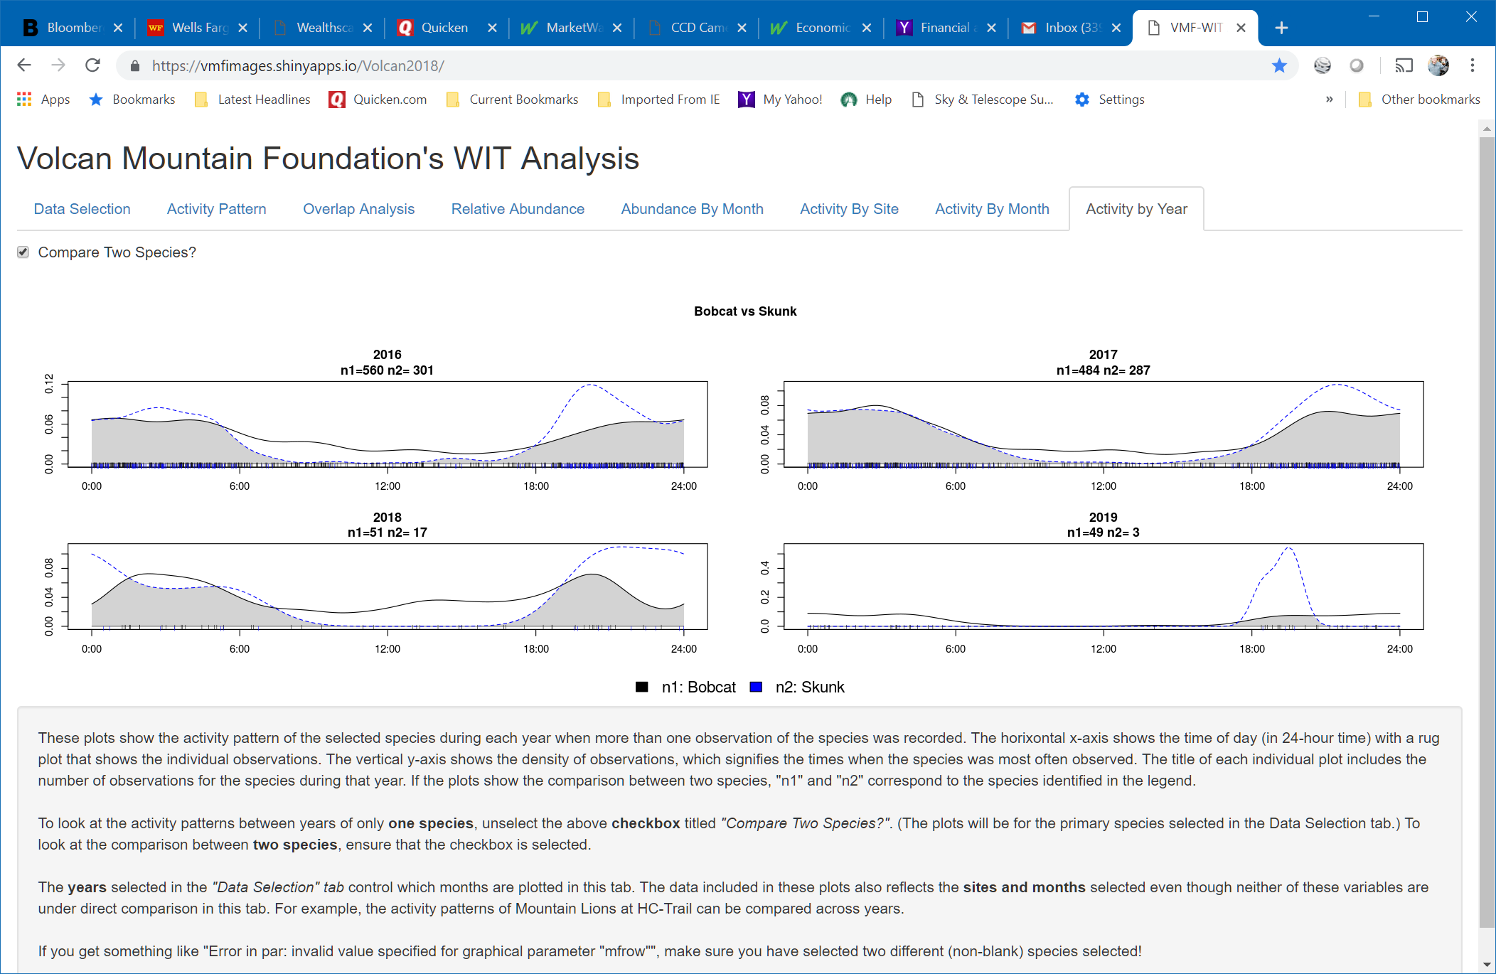

Slide 22
Future Capabilities for Google Sheets/R-Shiny
Add “Initial Active Date” and “Last Update Date” for site selection.
Add species relative abundance graphic by site to Google Maps.
Add automated link between “Image” number on Google Sheet and the image database.

Slide 23
The Nuts and Bolts of Google Sheets and R-Shiny
Introduce Amy
What Exactly does Google Sheet and R-Shiny Do?

Slide 24
Google Drive: https://drive.google.com/open?id=11T_kid9jjWnXVkUwJz99o_O9-w6-axi_5CyxKHFzA04
Rshiny Web Application:
https://vmfimages.shinyapps.io/Volcan2018/

Slide 25
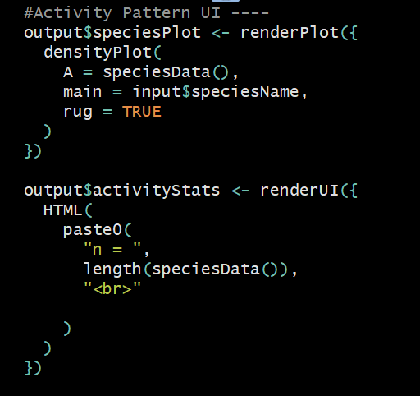
Server Function: Analysis Run in R

Slide 26
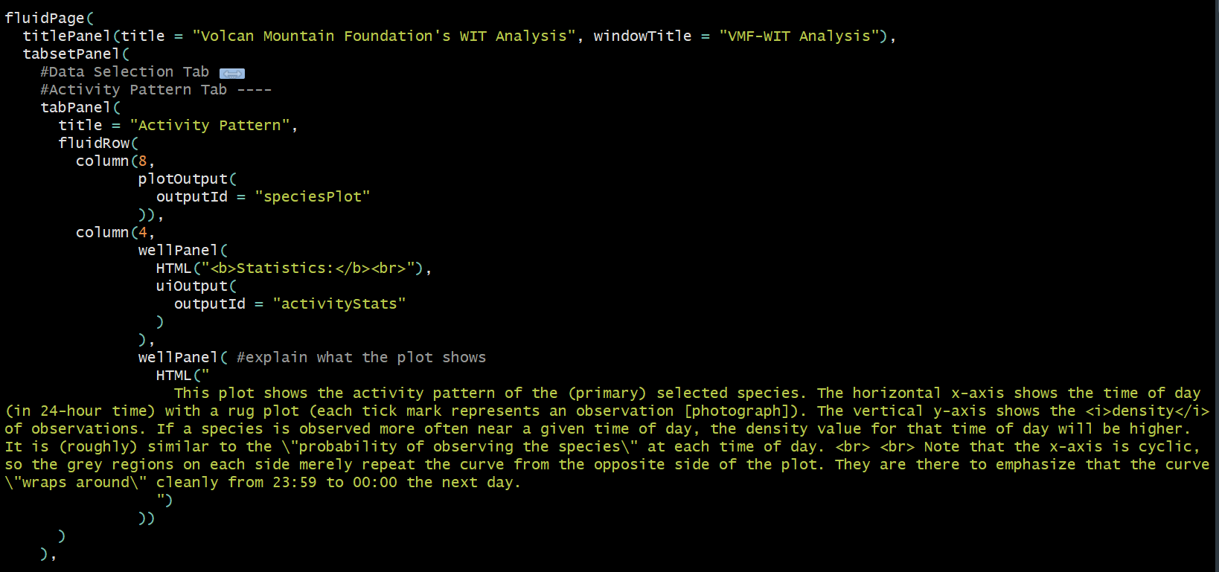
UI Function: Creates user interface

Slide 27
How You Can Work with R-Shiny on Your Projects
Dr. Mike Mooring - PLNU Biology – mmooring@pointloma.edu
Dr. Ryan Botts – PLNU Associate Professor of Mathematics – rbotts@pointloma.edu
Amy Eppert – aeppert98@hotmail.com

